Slide 1
CobraCAD

Slide 2
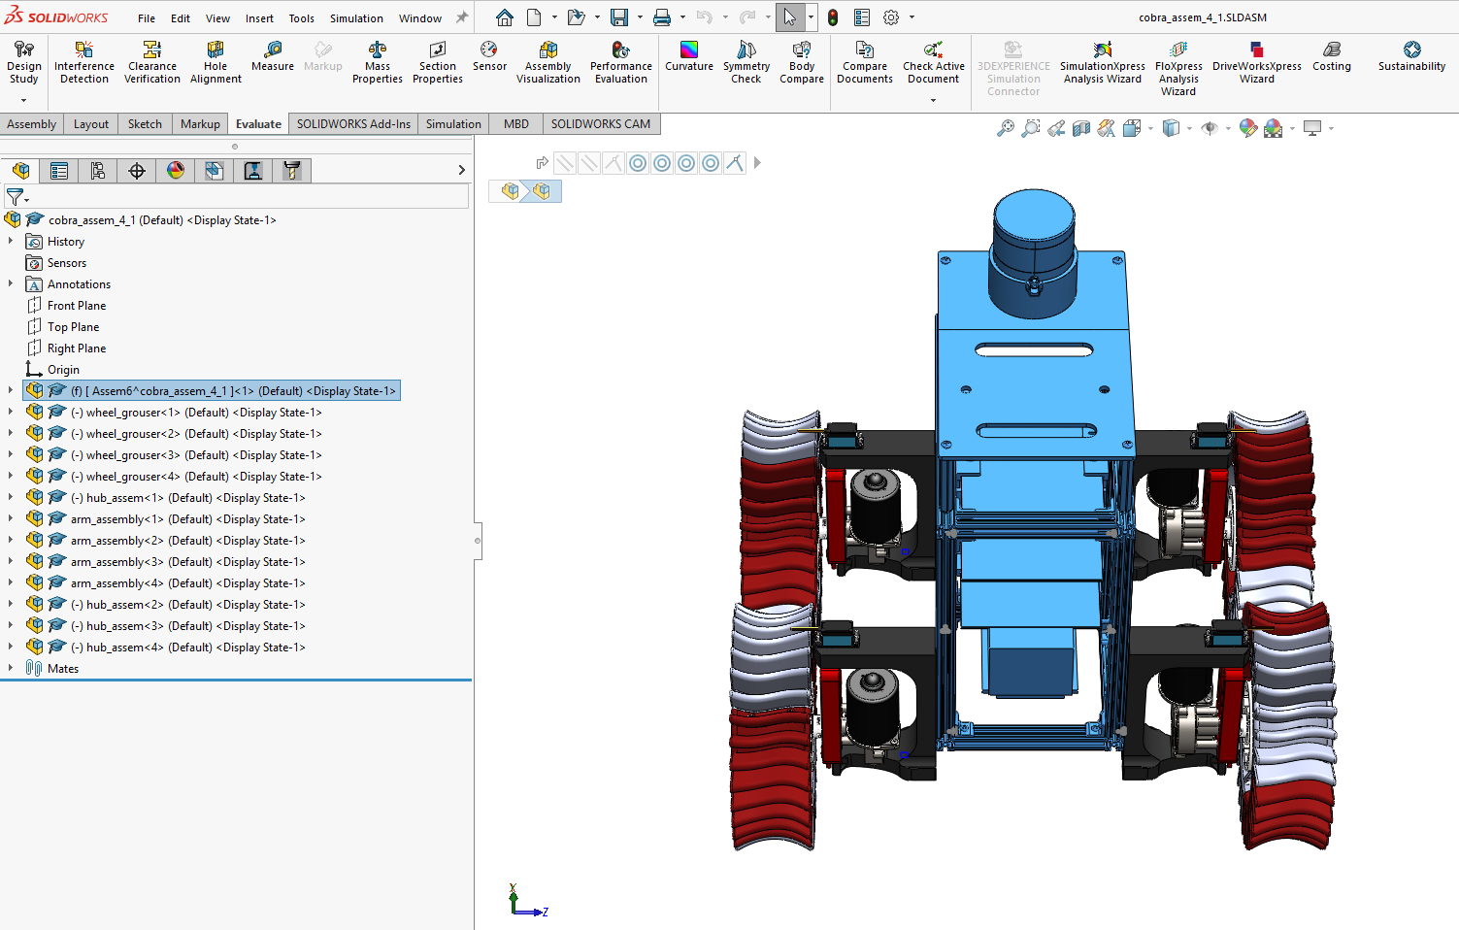
Full model (cobra_assem_4_1.SLDASM) With Lidar
wheel_grouser-1: FR (1)
wheel_grouser-2: FL (3)
wheel_grouser-3: RR (2)
wheel_grouser-4: RL (4)
hub_assem-1: FR (1)
hub_assem-2: RL (4)
hub_assem-3: FL (3)
hub_assem-4: RR (2)
arm_assembly-1: FL (3)
arm_assembly-2: FR (1)
arm_assembly-3: RR (2)
arm_assembly-4: RL (4)

Slide 3
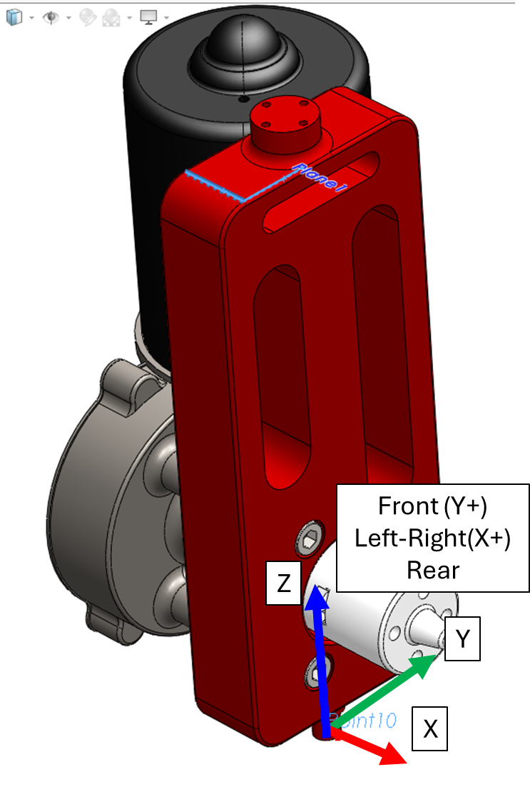
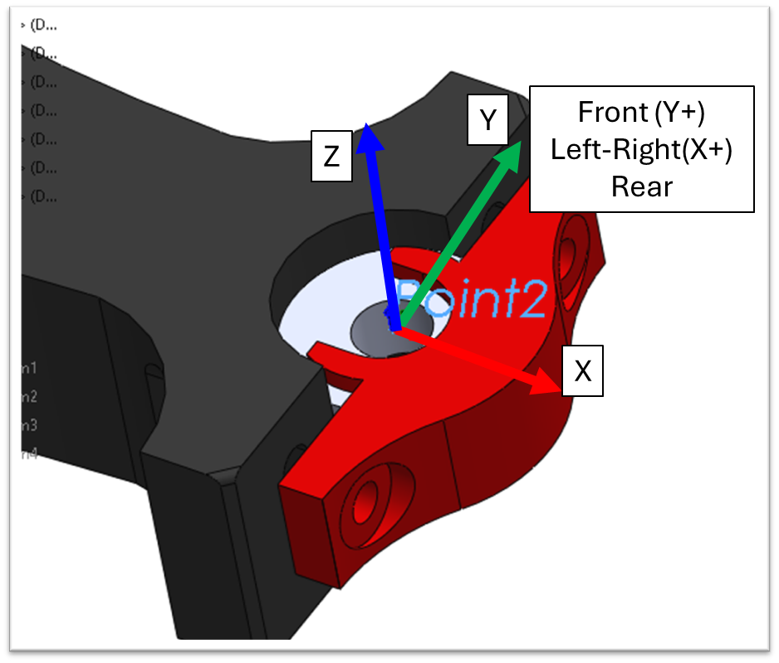
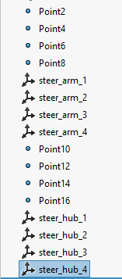
Steering (Arm(base)-Hub Rotating Axis)
Same for all similar assemblies.
Frame when steering = 0
Frame relative to chassis

Slide 4
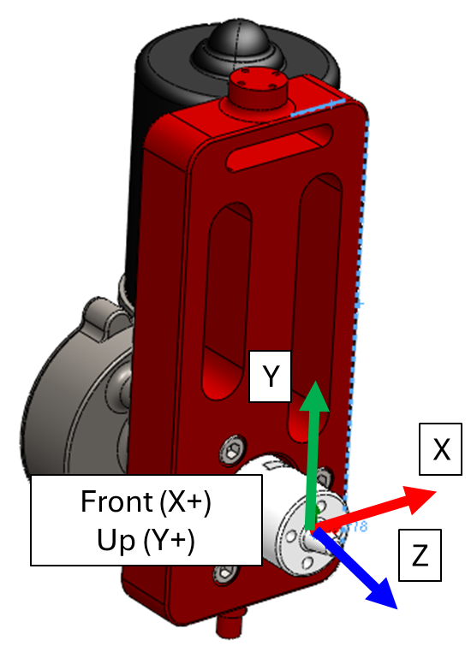
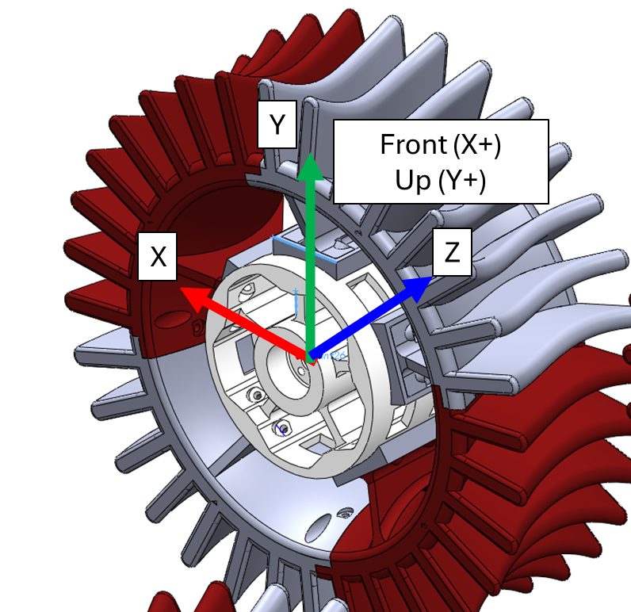
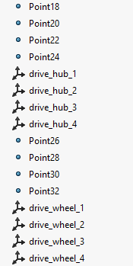
Wheel Drive (Hub(base)-Wheel Rotating Axis)
Same for all similar assemblies.
Frame when steering = 0
Frame when all input=0

Slide 5
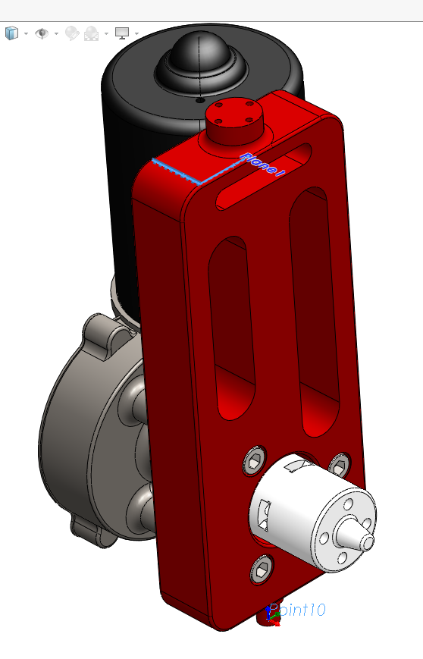
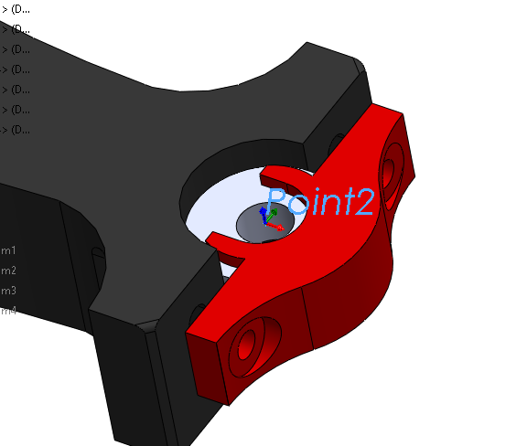
Y
Front (Y+)
Left-Right(X+)
Rear
Z
X
Front (Y+)
Left-Right(X+)
Rear
Z
Y
X

Slide 6
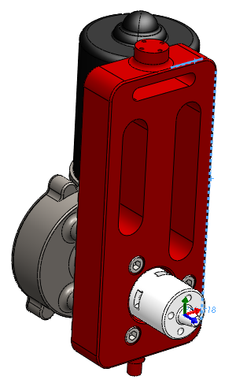
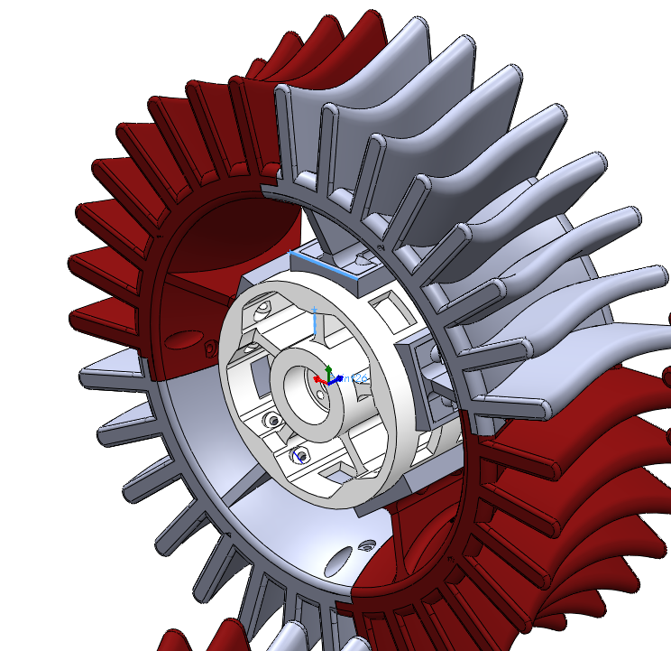
Y
Front (X+)
Up (Y+)
X
Z
Y
X
Front (X+)
Up (Y+)
Z

